Slide 1
COVID-19 DETECTION
USING NEURAL NETWORKS

Slide 2
TEAM MEMBERS:
Chandrashekar V - ENG19CS0070
Chethan Rao S - ENG19CS0076
Dileep Kumar S R - ENG19CS0086

Slide 3
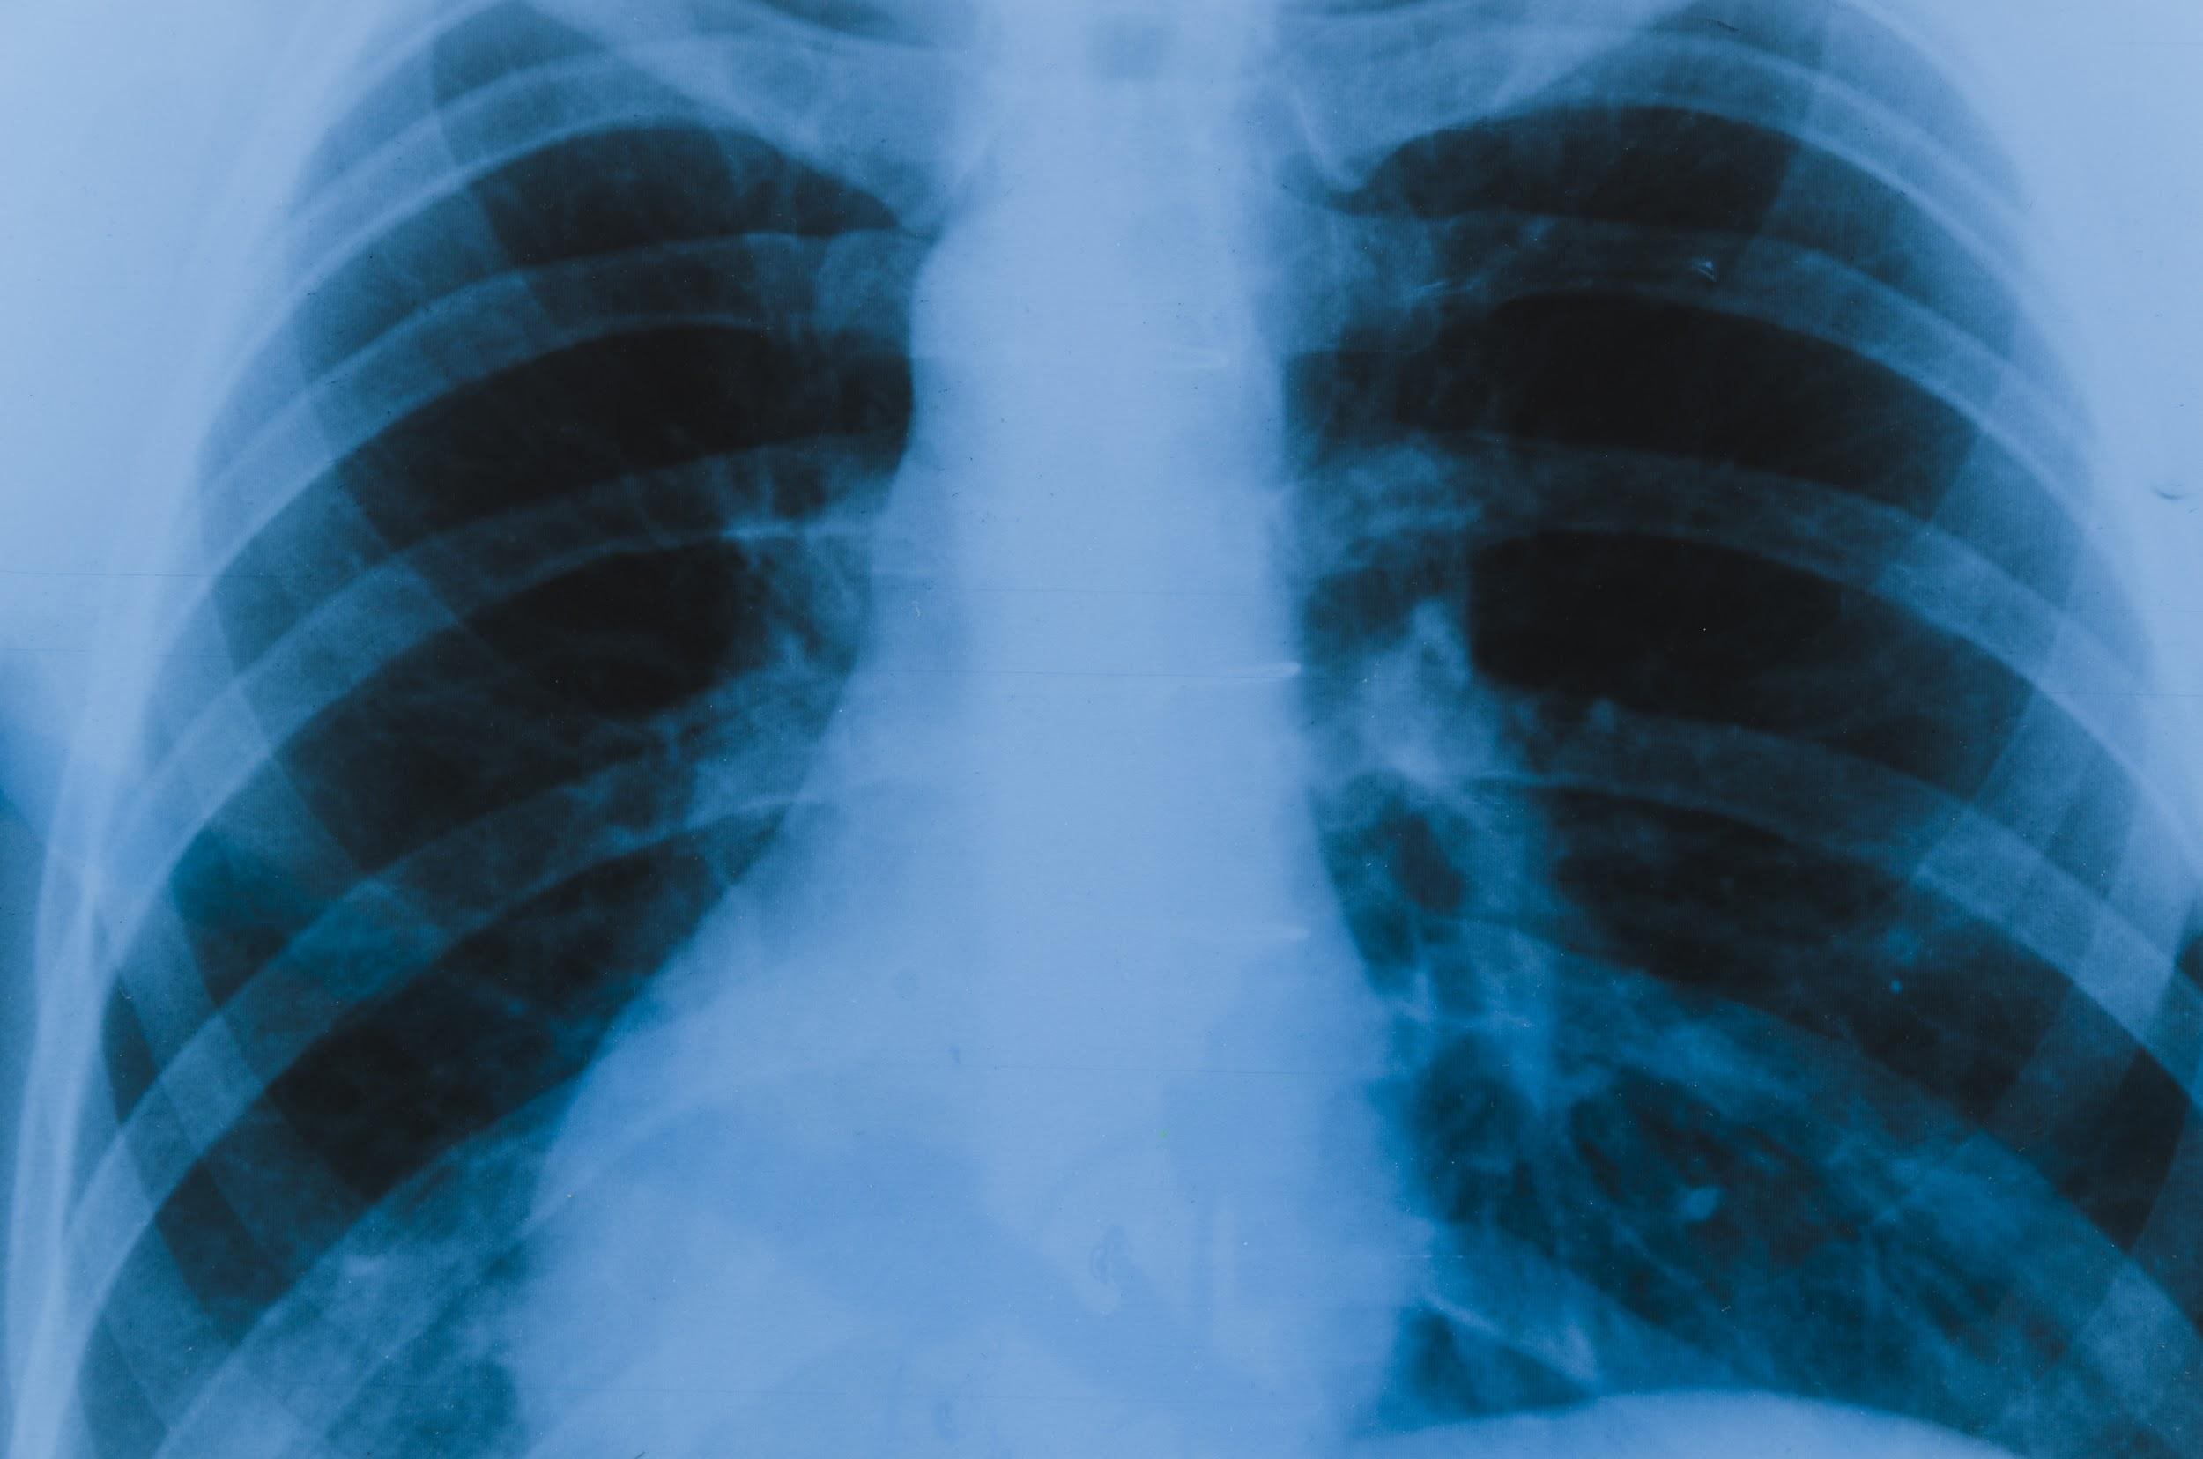
PROBLEM STATEMENT
we aim to develop a deep learning-based system for the persuasive classification and reliable detection of COVID-19 using chest x-ray images. Firstly, we evaluate the performance of various state-of-the-art convolutional neural networks (CNNs) proposed over recent years for medical image classification. Secondly, we develop and train CNN from scratch. In both cases, we use a recently published public X-Ray dataset for training and validation purposes.

Slide 4

Table of Contents
01
02
03
Introduction
Libraries and dataset used
Applications

Slide 5
INTRODUCTION
Neural network architecture
01

Slide 6

In neural networks, Convolutional neural network (ConvNets or CNNs) is one of the main categories to do images recognition, images classifications. Objects detections, recognition faces etc., are some of the areas where CNNs are widely used.

Slide 7
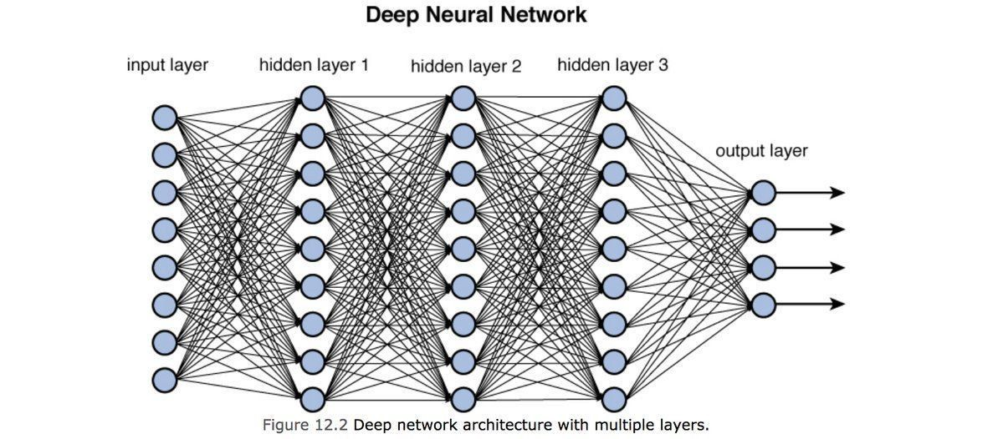

Slide 8
CNN LAYERS
We have created 4 CNN layers and followed by classification layers.
The model is going to be sequential.
The activation function used after each layer is "relu“.
The Convolutional layers are flattened into a single matrix of neuron outputs and passed to the further traditional NN layers.
The Neural Network is trained for 10 epochs (Iterations) and gives us the training accuracy of 96%.

Slide 9
Library and
dataset used
02

Slide 10
Library
KERAS:
Keras is an open-source software library that provides a Python interface for artificial neural networks. Keras acts as an interface for the TensorFlow library.
It is a Python-based framework that makes it easy to debug and explore. Highly modular neural networks library written in Python. Developed with a focus on allows on fast experimentation

Slide 11
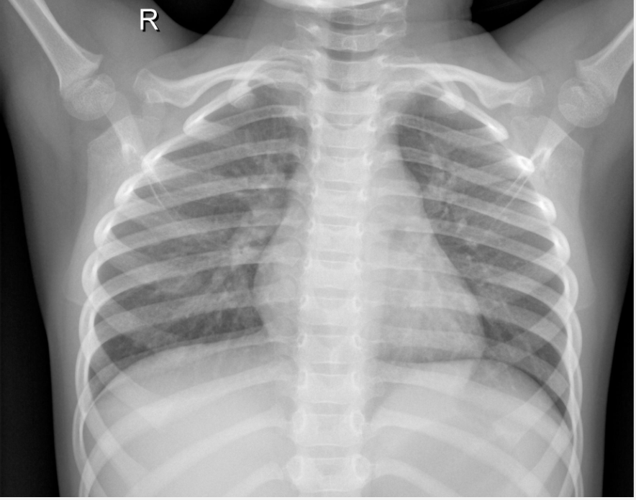
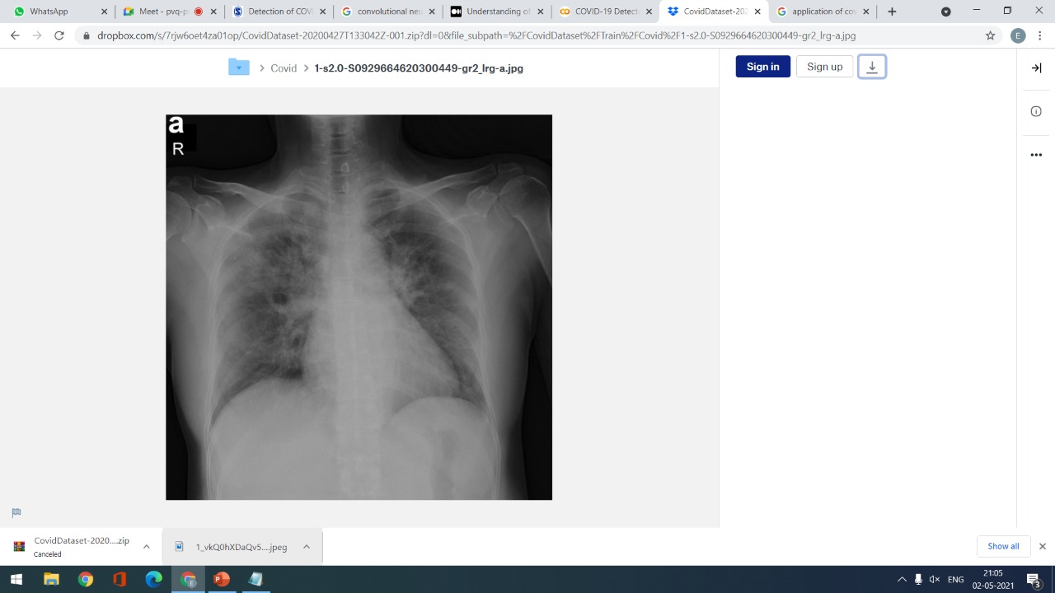
DATASET
The X Ray dataset was obtained from Kaggle.
It contains about 5,863 images of X rays in order to train our Neural Network.
The dataset is organized into 3 folders (train, test, val) and contains subfolders for each image category (Pneumonia/Normal). There are 5,863 X-Ray images (JPEG) and 2 categories
Non COVID
COVID

Slide 12
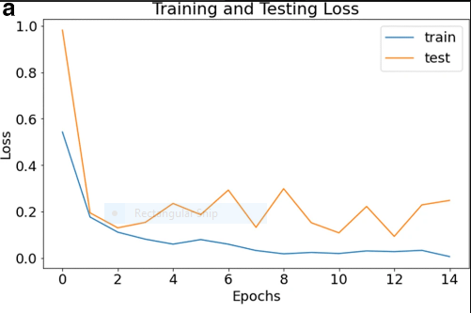
RESULTS:

Slide 13
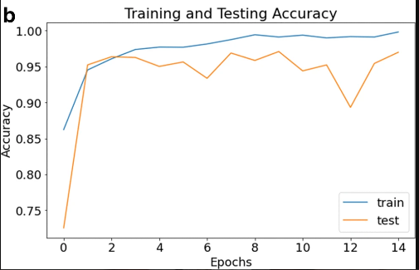

Slide 14
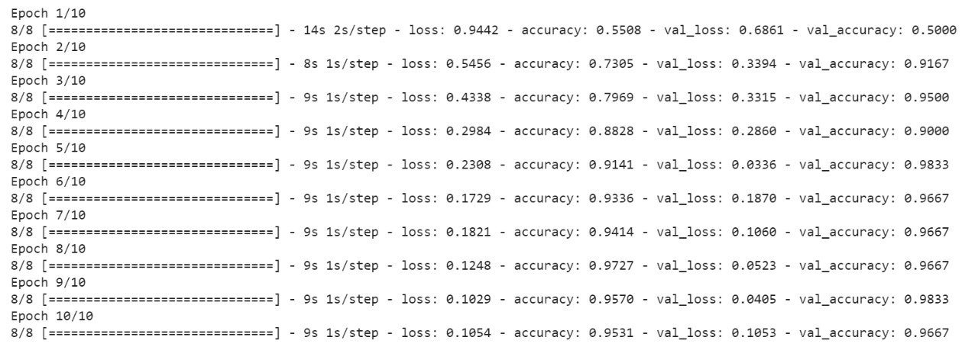
OUTPUT:

Slide 15
03
APPLICATIONS

Slide 16
APPLICATION
Covid situation is affected all across the world and there is a need of doing rapid testing,rapid evaluation of result.so in order to automate that task this project helps a lot.
The reason for using particularly x-ray images is because the cost of blood test is more and even it takes lot of time.
One more thing is we can detect the extent of spread of the virus using chest X-ray dataset.
This model provides the result faster than doing manually and also it takes lot to time.

Slide 17
Conclusions
Covid-19 detection using Neural Networks is a much faster if not much more accurate than the traditional test being performed.
This can be verified by testing it against new data that is made public shortly.
In the future, the large dataset for chest X-rays can be considered to validate our proposed model on it. It is also advised to consult medical professionals for any practical use case of this project.

Slide 18
THANK YOU..

